Slide 1
Bostorek
Reader’s Heaven
CREATED BY:
Shashank Paliwal
Piklu De
Shubham Jaiswal

Slide 2
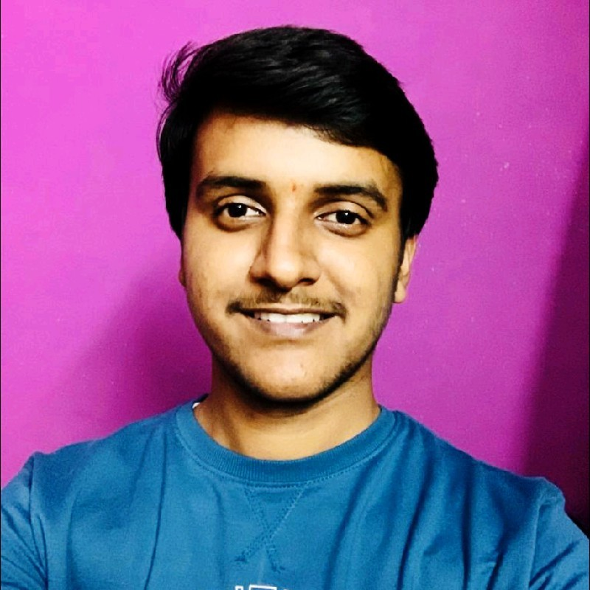
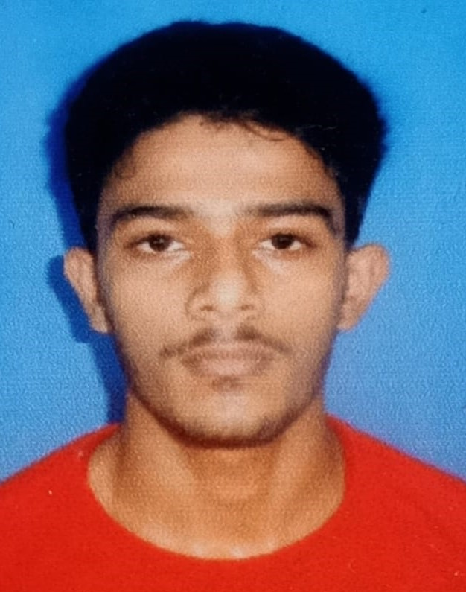
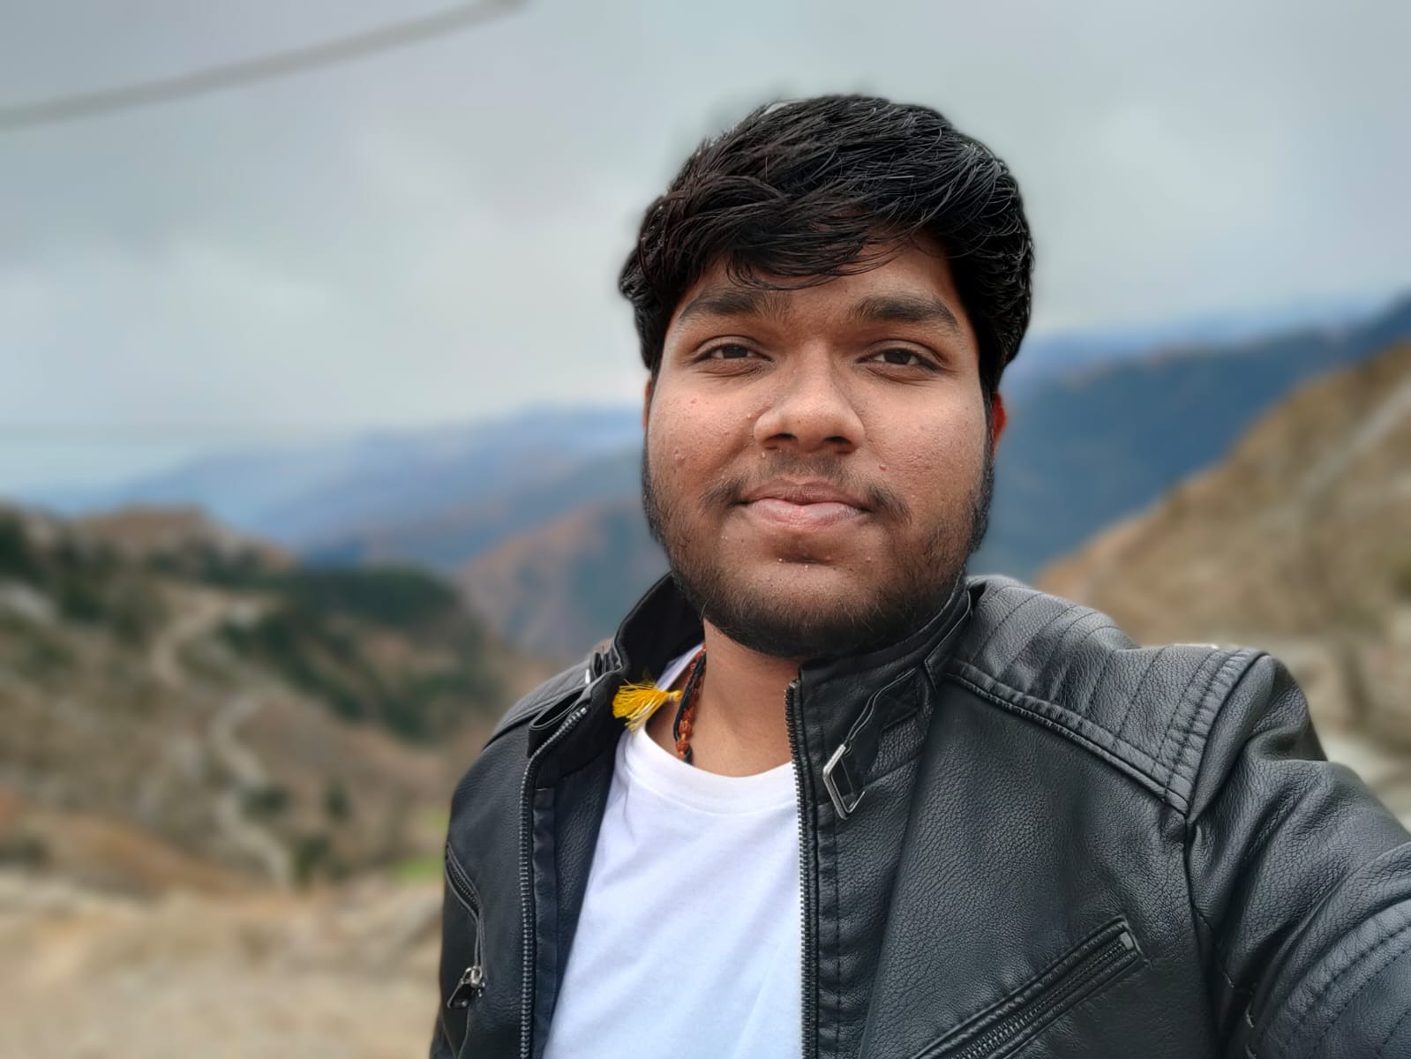
CREATORS DETAILS:
Shashank Paliwal:
SAP ID- 500095932
ROLL NO- R2142210945
BATCH- 6
Piklu De:
SAP ID- 500096448
ROLL NO- R2142211127
BATCH- 6
Shubham Jaiswal:
SAP ID- 500096554
ROLL NO- R2142211137
BATCH- 6

Slide 3
OVERVIEW:
In this Project, We are trying to build SAAS project which can be accessed via internet (Web Application) in which people or authors who are not recognized well yet in the society, and because of that they are not able to publish or sell their books in a huge numbers can place it in our website and we will help them to distribute their books over multiple regions. Along with books, novels a person can also put his thesis, research paper and views over the site.
It is basically a E-Commerce web application which only sells books in three formats -
Hard Copy
PDF’s(T&C)
Audio Books

Slide 4
What this Project will offer the Users?
This Project will offer the customers to purchase books of the under recognized authors and will able to get the books at their respective destinations.
Moreover, they will be able to get the PDF and Audio format of the books with some T&C applied.
They have multiple facilities as same as the big e-commerce sites have viz Reviewing books in public only after purchase, replacement in case of damaged order.
The price distribution of the books in multiple formats will be different.
Customers can also review / rate the book.
Customer can also decide that his/her review should be seen by specific person, publicly, or by any community and with this feature we will achieve customization to some extent.
There will be some sort of subscription plans with which user will leverage some extra features of the site like, lifetime access of books, instant notification when a new book is added to the database.
With the help to recommendation system we can also recommend books to user (This can be done by analysing the reading history of user) .
The next slide will introduce how the project looks like when fully completed.
* It is just a prototype representation, not the original!

Slide 5
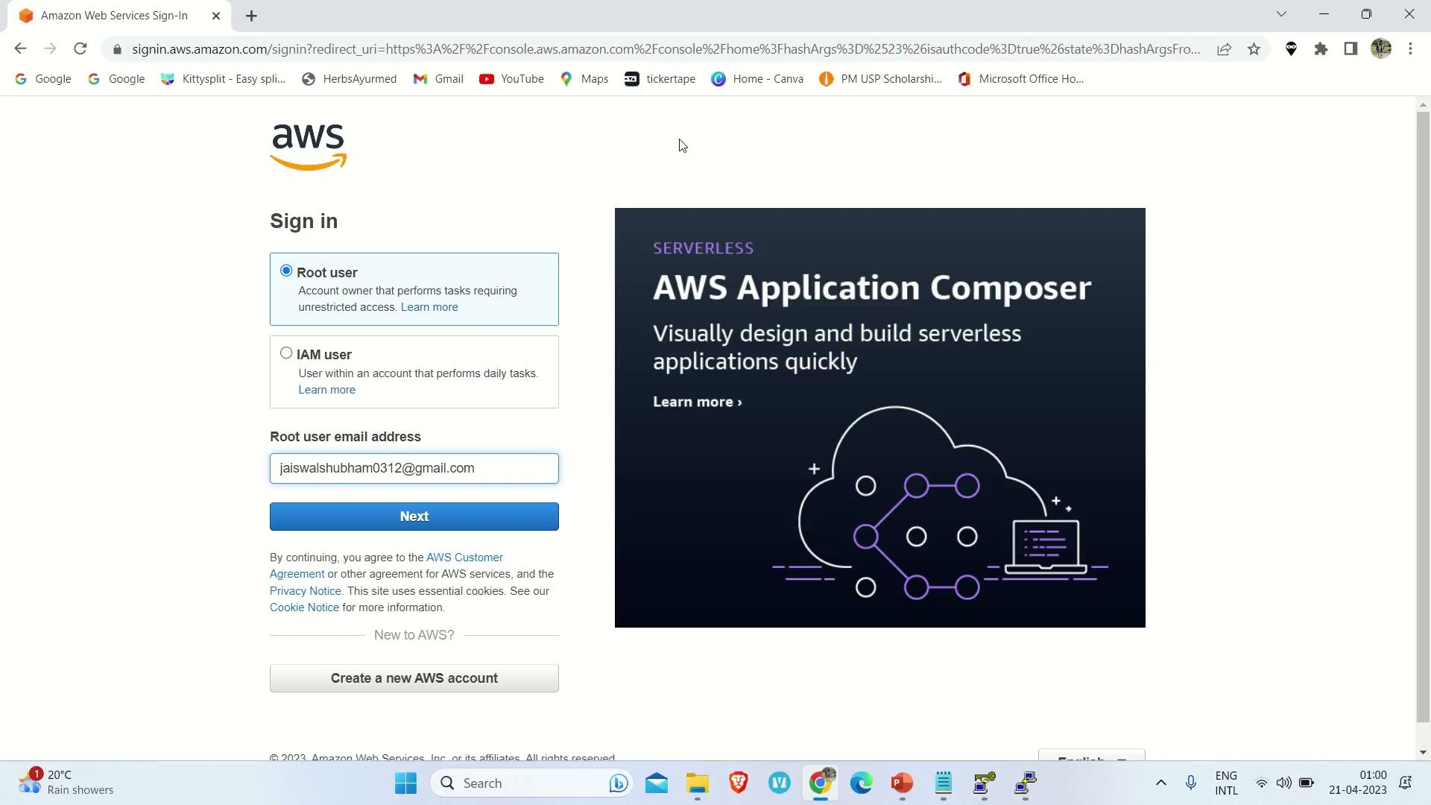

Slide 6

ALB:

Slide 7
AWS WAF:

Slide 8
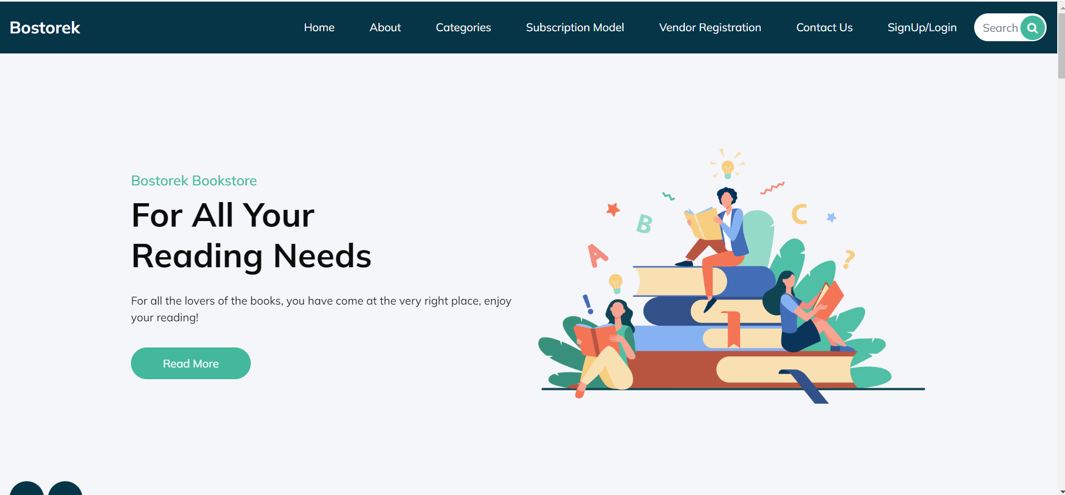

Slide 9
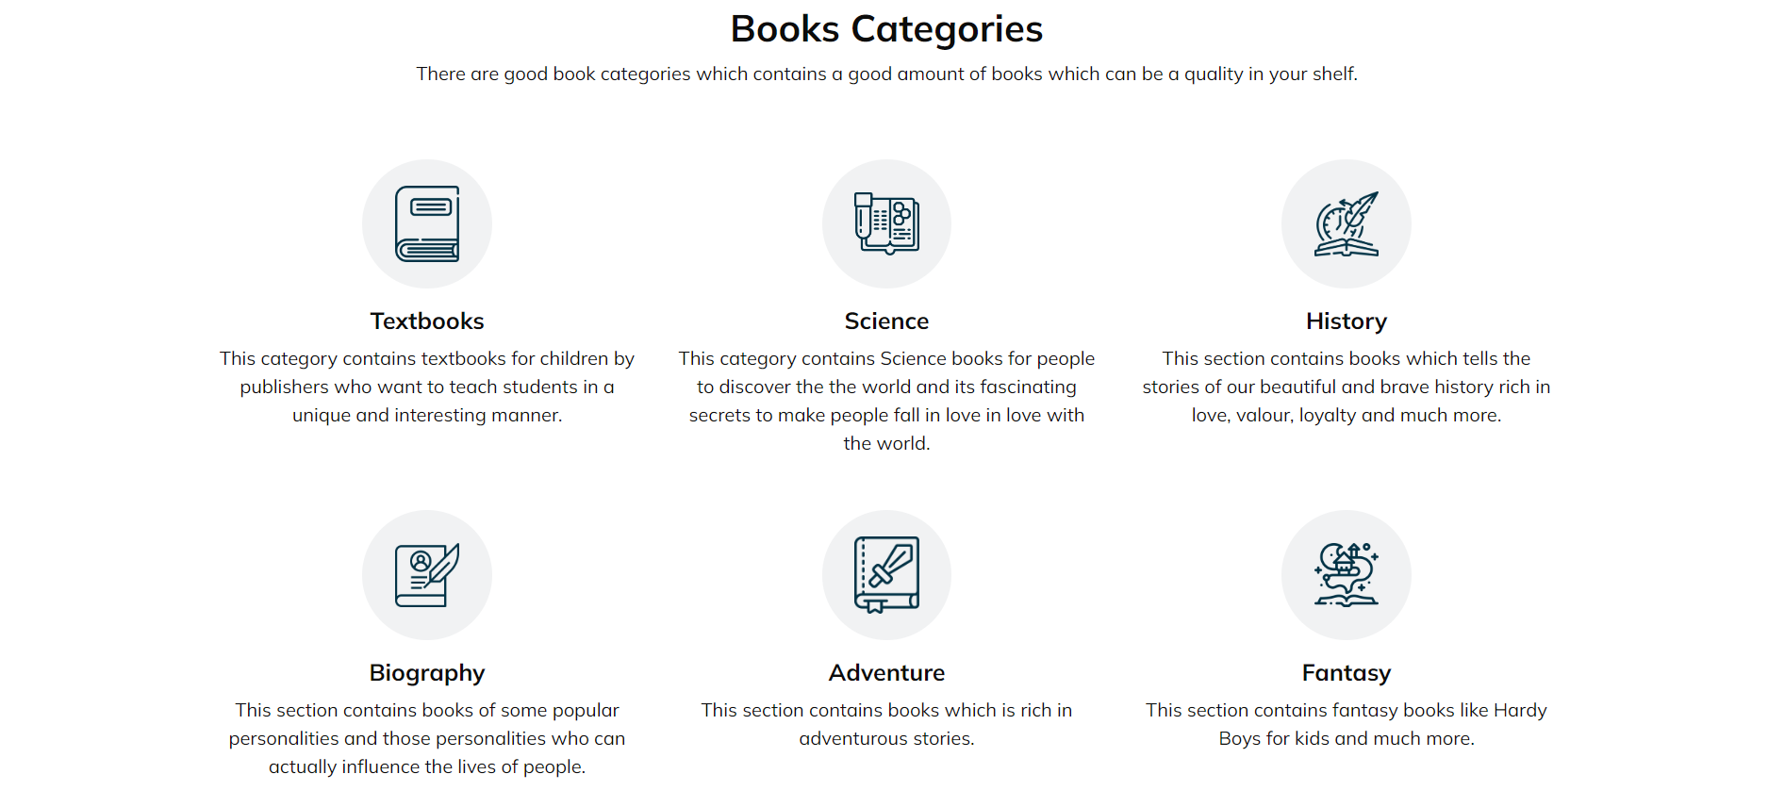

Slide 10
ROLES:
Shashank Paliwal:
The Role in the project was to integrate AWS WAF(Web Application Firewall) with the project and Database Management using MariaDB.
Piklu De:
The Role in the project was to integrate AWS’s Application Load Balancer Service with the project and also played a huge part in creating the Frontend.
Shubham Jaiswal:
The Role in the project was to operate the Database using the CPanel in the CentOS and also worked on the Cloudflare security.
All of the Team Members have helped each other in each of the Services!!

Slide 11
Thank YOU!

